Slide 1
CHAPTER 1
APPLICATIONS OF INTEGRATION
(Review)

Slide 2
Integration: the basic idea is
1. Divide the problem into small problems
2. Replace each small problem by a similar but simple problem that we can handle by approximation method
3. Sum up the results of the simple problems and go to the limit

Slide 3
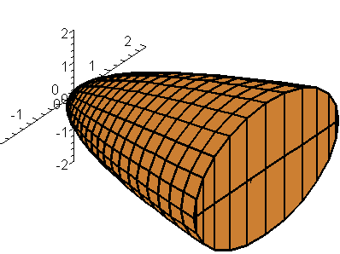
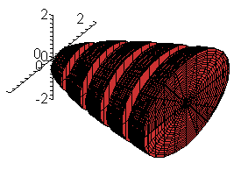
1. Volumes
To calculate the volume of a solid S,
we slice S into pieces by the planes perpendicular to the x-axis and approximate each piece by a cylinder

Slide 4
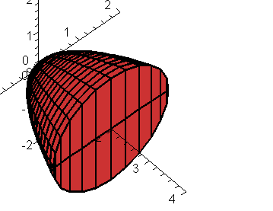
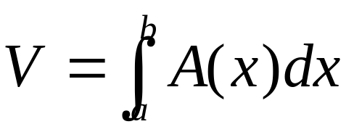
Consider a cross-section of S by a plane perpendicular to the x-axis at the point x. Let A(x) be the area of this section. We assume that A(x) is a continuous function
A(x)
x
Then the volume of S is

Slide 5
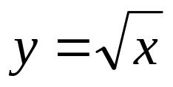
2. Solids of Revolution
A solid of revolution is obtained by rotating a region in the plane about a line (the axis of rotation).
The cross-section by a plane P_{x} perpendicular to this axis is:
a circle of radius r and area A(x) = πr² or
an annular ring of radii r₁, r₂ and area
A(x) = πr₂² – πr₁ ²
Example. Find the volume of the solid obtained by rotating about the x-axis the region under the curve from 0 to 1

Slide 6
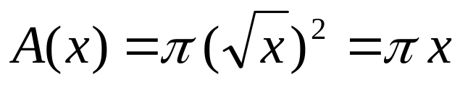
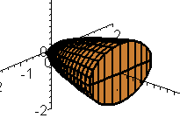
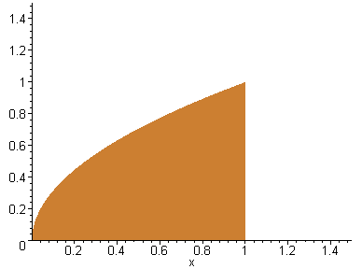
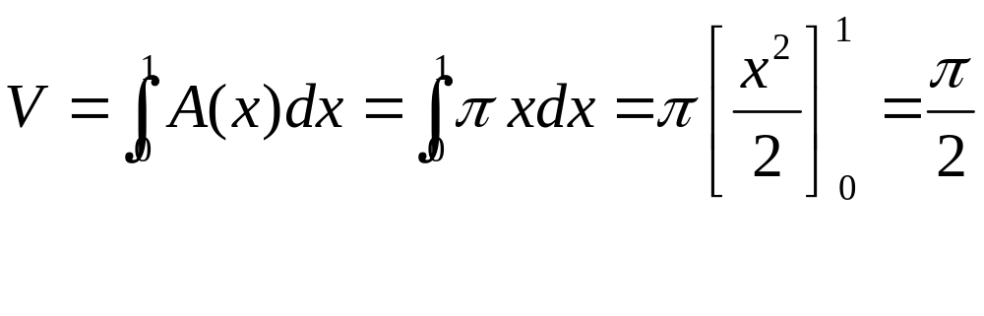
Solution. The solid of revolution is a paraboloid
The area of a cross-section through x is
Hence the volume is

Slide 7
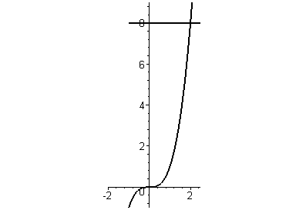
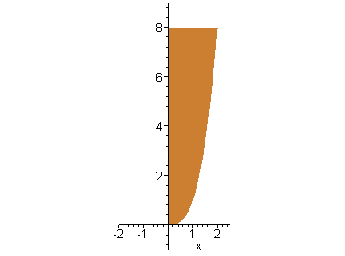
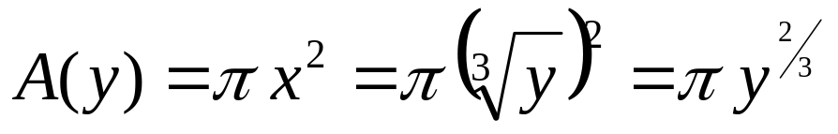
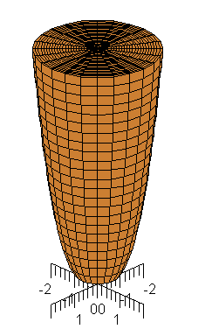
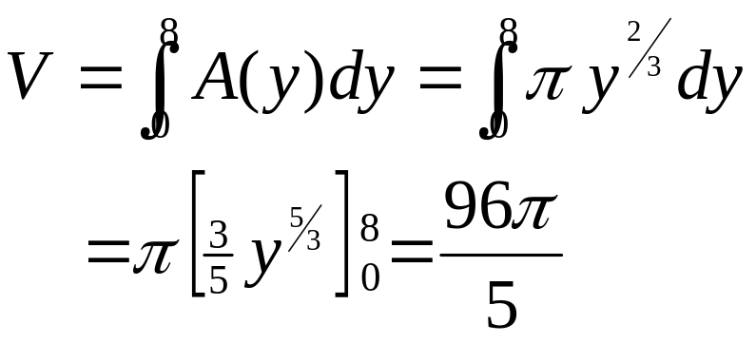
Example. Find the volume of the solid obtained by rotating about the y-axis the region bounded by y=x³, y=8 and x=0
Solution. The result is the solid shown below.
The area of a cross-section through y is
The volume of the solid is

Slide 8
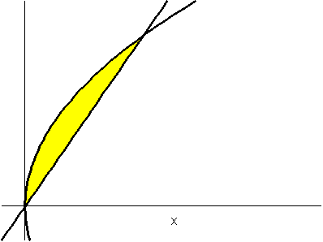
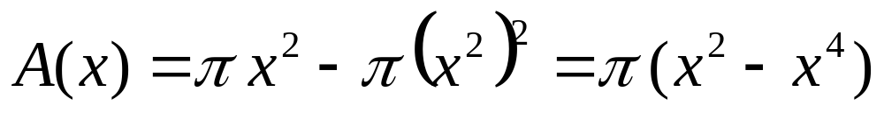
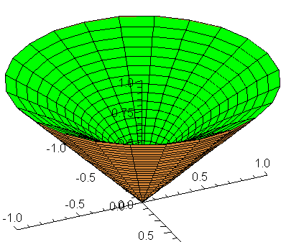
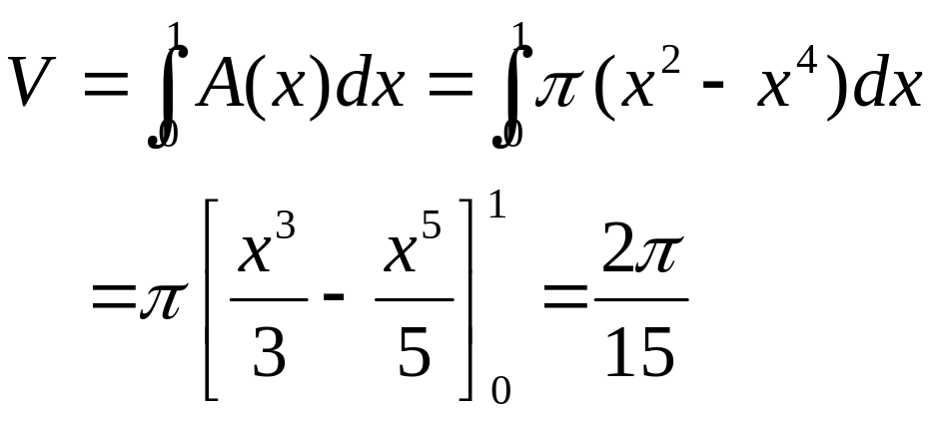
Example. Find the volume of the solid obtained by rotating about the x-axis the region bounded by y = x and y = x²
Solution.
x
The cross-section through x is an annular ring with area
y
Therefore

Slide 9
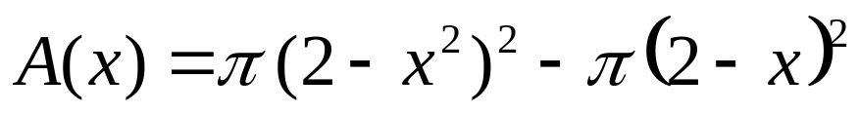
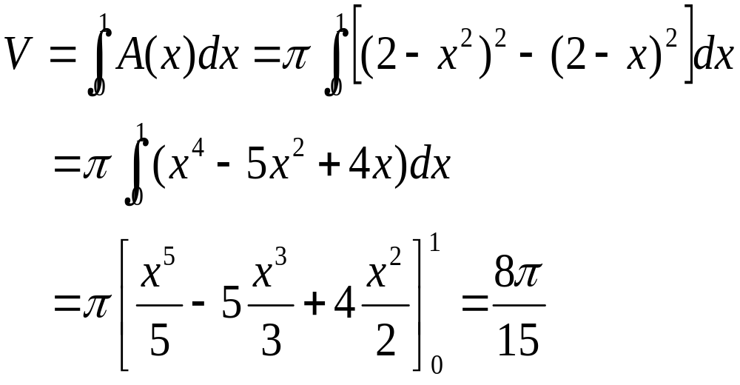
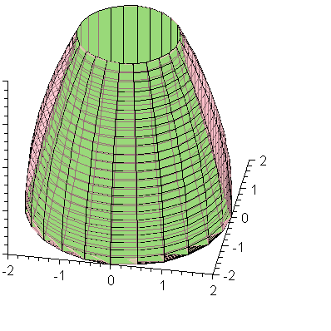
Example. Find the volume of the solid obtained by rotating about the line y = 2 the region bounded by y = x and y = x²
Solution. The cross section is an annular ring with area
x
Therefore the volume of the solid is
y

Slide 10
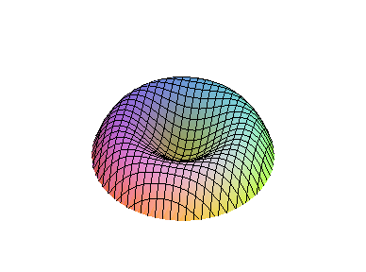
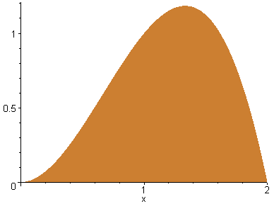
3. Cylindrical Shells
Sometimes it is difficult to handle the volume problem by slicing methods.
For instance let find the volume of the solid of revolution on the right obtained by rotating the region on the left about the y-axis
y=2x² – x³
x_{L}
x_{R}

Slide 11
To apply slicing methods as in 2.2.2, we have to find the inner and outer radius of the cross-section.
To do that we have to solve the equation
2x² – x³ = y
for x in terms of y, which is difficult
However we also have the method of cylindrical shells.
Instead of slicing the solids into cylinders or annular rings of small height as in 2.2.2,
we approximate the solids using very thin cylindrical shells

Slide 12

Example. Find the volume of the solid obtained by rotating about the y-axis, the region under the curve y = 2x² – x³
Solution. We divide the interval [0, 2] into n subintervals of equal width Δx.
When being rotated about the y-axis, a typical rectangle generates a cylindrical shell of radii x_{i-1} and x_{i} and height 2(x_{i}*)² - (x_{i}*)³ where x_{i}* is a sample point in [x_{i-1}, x_{i}]
y=2x² – x³
Δx

Slide 13
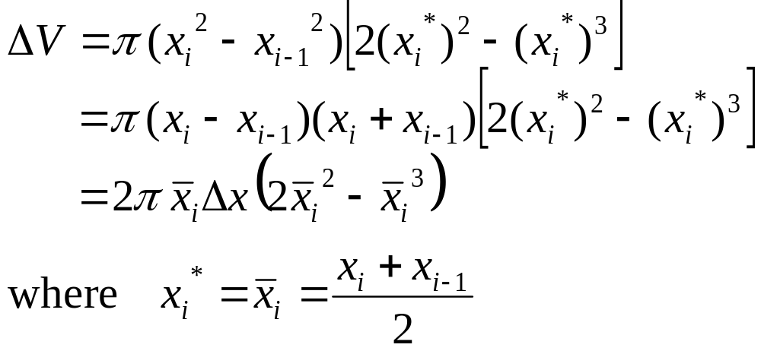
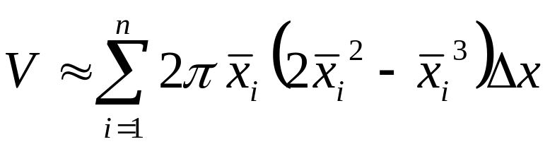
The volume of the cylindrical shell is
Hence

Slide 14
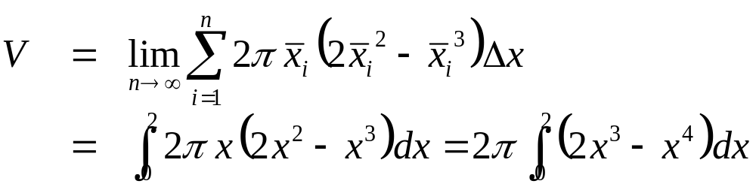
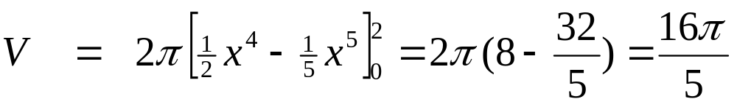
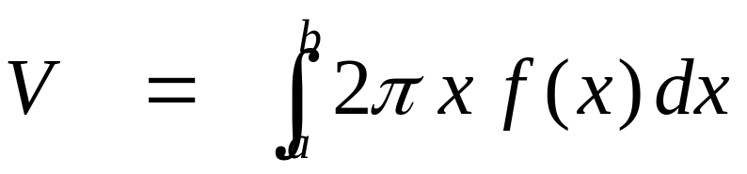
Letting n→∞ we will obtain the volume of the solid
In general if we rotate the region under the curve y =f(x) about the y – axis, then the volume is
y=f(x)
a
b

Slide 15
4. ARC LENGTH
Let C be a smooth parametric curve
x = f(t), y=g(t) a ≤ t ≤ b
We divide [a, b] into n subintervals of equal width Δt with the endpoints t₀, t₁, t₂, …, t_{n},
then x_{i} = f(t_{i}), y_{i} = g(t_{i}) are coordinates of the points P_{i} = (x_{i}, y_{i}) lying on C.
P₂
P₁
P_{n}
P₀
P_{n-1}

Slide 16
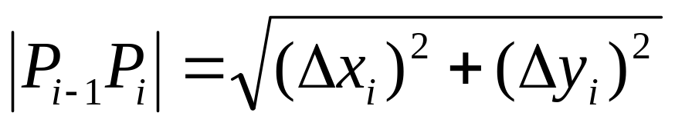
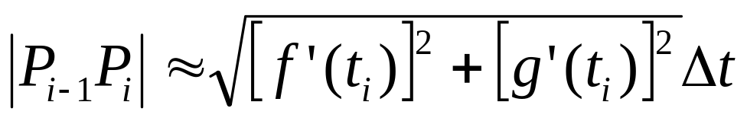
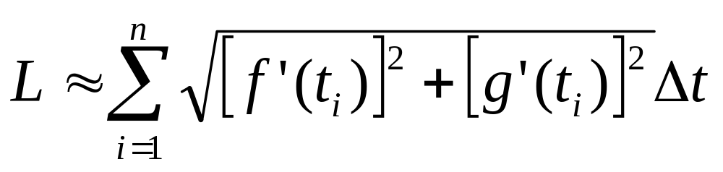
We approximate the length L of C by the length of the polygonal line P₀ P₁ P₂… P_{n}
Let Δx_{i} = x_{i} – x_{i-1} and Δy_{i} = y_{i} – y_{i-1} then the length of the line segment P_{i-1} P_{i} is
For Δt small we can approximate Δx_{i} and Δy_{i} by
Δx_{i} ≈ f '(t_{i}) Δt Δy_{i} ≈ g '(t_{i}) Δt
Hence
and

Slide 17
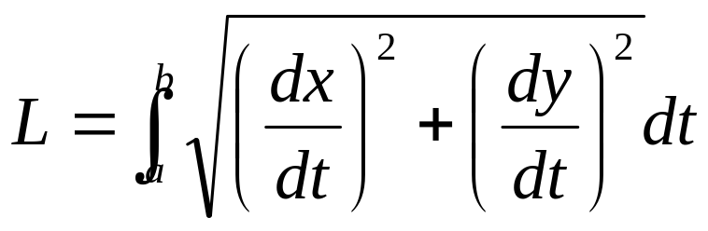
Arc Length Formula. Let C be a smooth curve with parametric equations x = f(t), y=g(t), a ≤ t ≤ b.
If C is traversed exactly once as t increase from a to b , then its length is

Slide 18
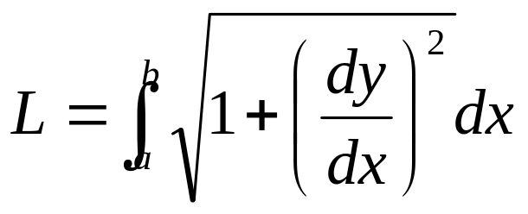
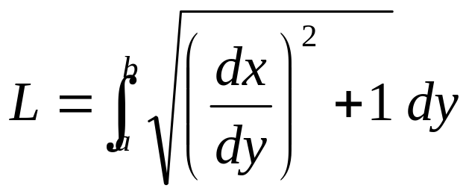
Note. If the curve is given by the equation y=f(x), a ≤ x ≤ b, then we can regard x as a parameter and the parametric equations are
x = x, y = f(x)
And the Arc Length Formula becomes
Similarly if the curve is given by the equation x=f(y), a ≤ y ≤ b, then y becomes the parameter and

Slide 19
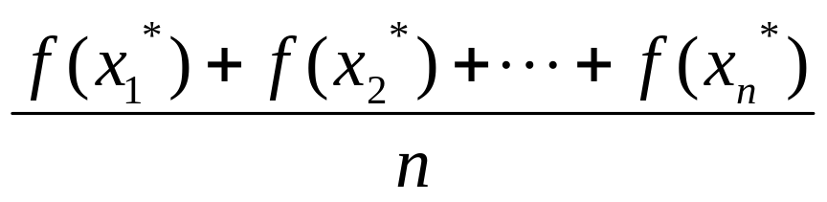
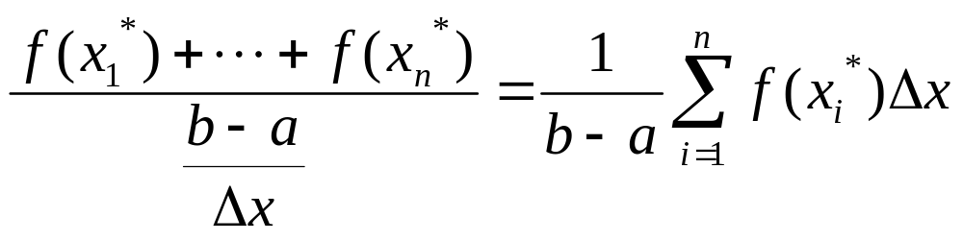
5. Average Value of a Function
To get the average value of a function f(x), a ≤ x ≤ b
we divide the interval [a, b] into n equal subintervals and compute the average value of the sample points y₁*, y₂*, …, y_{n}* selected in these intervals

Slide 20
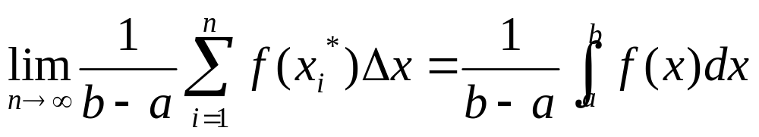
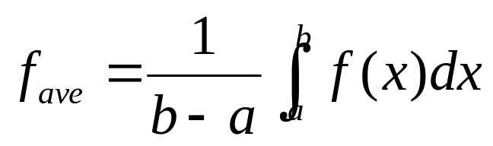
If we take sample values at a large number of points then the average value approaches a limiting value
Therefore the average value of a function f on the interval [a, b] is defined as

Slide 21
6. Work
How the work is defined if the force is not constant ?
Suppose that the object moves along the x-axis in the positive direction from x=a to x=b, and the force f(x) acts on the object at the point x is a continuous function.
We divide [a, b] into n subintervals of equal width Δx by the end points x₀, x₁,…, x_{n}
and choose sample point x_{i}* in the i^{th} subinterval.
x₁* x₂* . . . x_{i}* . . . x_{n}*
a=x₀ x₁ x₂ . . . x_{i-1} x_{i} . . . x_{n-1} b= x_{n}

Slide 22
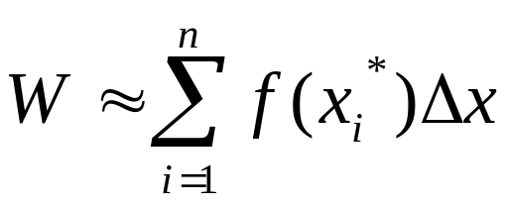
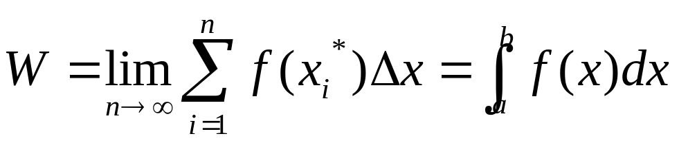
If n is large, we can assume the force is constant and equal to f(x_{i}*) in [x_{i-1}, x_{i}].
Then the total work is approximated by
Letting n→∞ we can defined the work done in moving the object from a to b by

Slide 23
8. Hydrostatic Pressure & Force
A thin horizontal plate with area A (m²) is submerged in a fluid of density ρ (kg/m³) at a depth d(m) below the surface of the fluid.
The volume of the fluid directly above the plate is V=Ad, and mass m=ρ V=ρ Ad.
The force exerted by the fluid on the plate is
F = mg =ρ gAd
Where g is the acceleration due to the gravity.
d
A

Slide 24
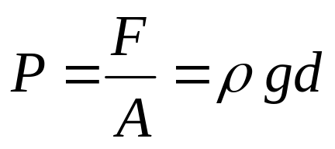
F=mg=ρgAd
The pressure P (pascals) on the plate is defined by
d
A
Note. At any point in the liquid, the pressure is the same in all directions.

Slide 25
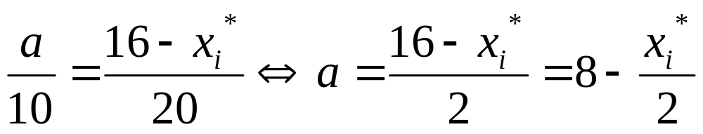
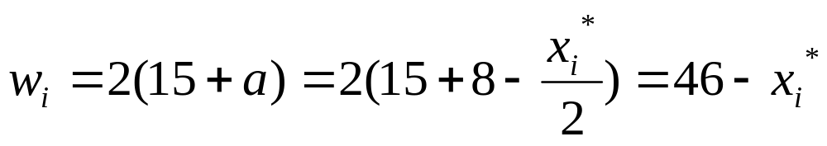
Example. Consider a dam as in the following picture
10m
50m
a
x_{i}
20m
30m
We divide [0, 16] into n subintervals of equal length with endpoints x_{i}, and choose x_{i}*∈[x_{i-1}, x_{i}].
We have
Therefore the width of the i^{th} strip is

Slide 26
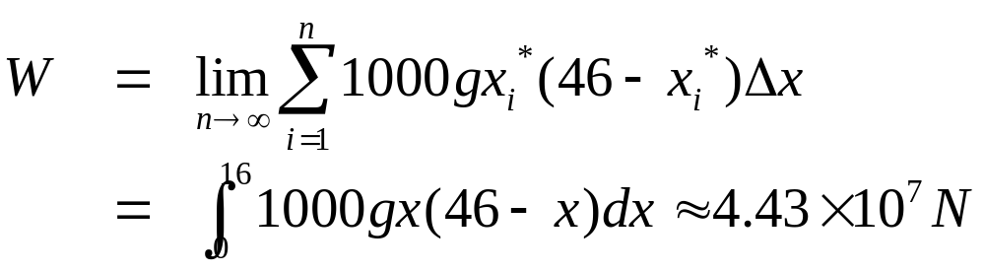
The area of the i^{th} strip is approximately
A_{i} ≈ w_{i} Δx = (46 – x_{i}*) Δx
10m
50m
a
x_{i}*
20m
If Δx is small the pressure on the i^{th} strip is constant
P_{i} ≈ 1000gx_{i}*
30m
The total hydrostatic force acting on the dam is

Slide 27
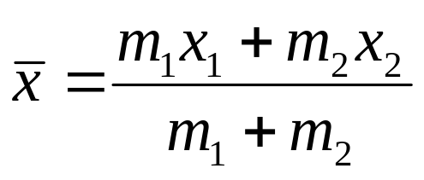
9. Moments & Center of Mass
To find the center of mass (or center of gravity) of a system consisting of two masses m₁ and m₂ attached to a rod of negligible mass on opposite sides of a fulcrum.
we apply the Law of Lever
m₁ d₁ = m₂ d₂
d₁
d₂
m₁
m₂
The x-coordinates of the center of mass is

Slide 28
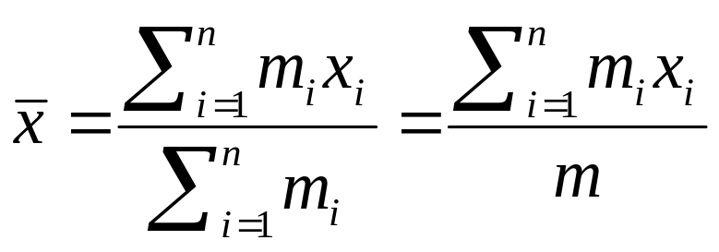
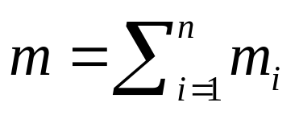
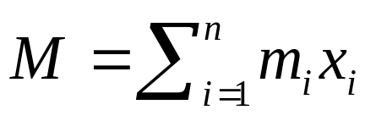

m₁x₁ and m₂x₂ are moments of the masses m₁ and m₂
In general if we have n masses m₁, m₂, …, m_{n} located at the points x₁, x₂, …, x_{n} on the x-axis, then the center of mass of the system is
is the total mass of the system and
is the moment of the system with respect to the origin

Slide 29
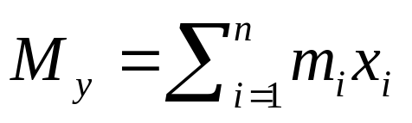
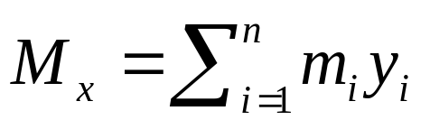

For a system of n particles with masses m₁, m₂, …, m_{n} located at the points (x₁, y₁), (x₂, y₂), …, (x_{n}, y_{n}),
Then the moment of the system about the y-axis is defined by
and the moment of the system about the x-axis is
and the coordinates of the center of mass are given by
(x₁, y₁)
(x_{n}, y_{n})
(x₂, y₂)

Slide 30
Now we consider a flat plate (a lamina) with uniform density ρ that occupies a region R in the plane.
We want to locate the center of mass of the plate called the centroid of R.
Note. If R is symmetric with respect to a line l then the center of mass lies on l.
In particular, the centroid of a rectangle is its center.
On the other hand if R = R₁∪R₂, R₁∩R₂=∅, then the moment of R is the sum of moments of R₁andR₂

Slide 31


Let R be the region under the curve y=f(x) from x=a to x=b, where f is a continuous function.
We divide [a, b] into n subintervals of equal width Δx with the endpoint x₀, x₁,…, x_{i},…, x_{n}.
We select the midpoint of [x_{i-1}, x_{i}] as the sample point x_{i}*
R is approximated by the rectangles R_{i} with base [x_{i-1}, x_{i}] and height f (x_{i}*).
The centroid and the mass of R_{i} are
x₀ x₁ x₂ . . . x_{i-1} x_{i} . . . x_{n-1} x_{n}

Slide 32




The moment of R about the y-axis is
and the moment of R about the x-axis is
The mass of the plate is
The coordinates of the center of mass are

Slide 33





Example. Find the center of mass of a semicircular plate of radius r
Solution. The equation of the semicircle is
By symmetry, the center of mass must lie on 0y, so

